Slide 1
Data Analytics with Machine Learning

Slide 2
Outline
Data Analytics with Machine Learning
Data Analytics
Traditional Paradigm
Machine Learning Paradigm
Branches in Machine Learning
Activities in this course

Slide 3

Data Analytics
The process of discover meaningful patterns in data
Nowadays, data is constantly collected and accumulated, however, knowledges in them are not apparent most of the times
Raw (just been collected) data must be manipulated to generate meaningful patterns
Free entry in 2 a wkly comp to win FA Cup final tkts 21st May 2005. Text FA to 87121 to receive entry question (std txt rate) T&C's apply 08452810075 over 18's
Oops, I'll let you know when my roommate's done
I‘m going to try for 2 months ha ha only joking
Nah I don't think he goes to usf, he lives around here though
WINNER!! As a valued network customer, you have been selected to receive a £900 prize reward! To claim call 09061701461. Claim code KL341. Valid 12 hours only.
I'm back, we're packing the car now, I'll let you know if there's room
Sorry, I'll call later in meeting.
Free entry in 2 a wkly comp to win FA Cup final tkts 21st May 2005. Text FA to 87121 to receive entry question (std txt rate) T&C's apply 08452810075 over18's
Oops, I'll let you know when my roommate's done
I'm back, we're packing the car now, I'll let you know if there's room
Nah I don't think he goes to usf, he lives around here though
WINNER!! As a valued network customer, you have been selected to receive a £900 prize reward! To claim call 09061701461. Claim code KL341. Valid 12 hours only.
I‘m going to try for 2 months ha ha only joking
Sorry, I'll call later in meeting.

Slide 4




Common Steps in a Data Analytics Project
I‘m going to try for 2 months ha ha only joking
i’m going to try for 2 months ha ha only joking
Number of text | 153213
Average text length | 10 words
Number of sender | 103401
Number of receiver | 101045
Free entry in 2 a wkly comp to win FA Cup final tkts 21st May 2005. Text FA to 87121 to receive entry question (std txt rate) T&C's apply 08452810075 over 18's
i be go to try for 2 month ha ha only joke
I'm back, we're packing the car now, I'll let you know if there's room
Cleaning
Preparation
Oops, I'll let you know when my roommate's done
Nah I don't think he goes to usf, he lives around here though
Word frequency
hello | 63421
bye | 34543
lol | 24204
ok | 15020
i be go try 2 month ha ha only joke
Sorry, I'll call later in meeting.
I‘m going to try for 2 months ha ha only joking
i | be | go | you | ha | bye | joke | …
1 | 1 | 1 | 0 | 2 | 0 | 1 | …
WINNER!! As a valued network customer, you have been selected to receive a £900 prize reward! To claim call 09061701461. Claim code KL341. Valid 12 hours only.
Raw data
Preliminary Analysis
0.13 | 0.85 | 0.17 | 0.53 | 0.12 | 0 | 0 | …
0.21 | 0.11 | 0.9 | 0.7 | 0 | 0 | 0 | …
0.44 | 0.22 | 0 | 0 | 0 | 0.10 | 0.81
Production
Evaluation
Free entry in 2 a wkly comp to win FA Cup final tkts 21st May 2005. Text FA to 87121 to receive entry question (std txt rate) T&C's apply 08452810075 over 18's
I'm back, we're packing the car now, I'll let you know if there's room
Oops, I'll let you know when my roommate's done
Nah I don't think he goes to usf, he lives around here though
Sorry, I'll call later in meeting.
I‘m going to try for 2 months ha ha only joking
Modeling
WINNER!! As a valued network customer, you have been selected to receive a £900 prize reward! To claim call 09061701461. Claim code KL341. Valid 12 hours only.

Slide 5

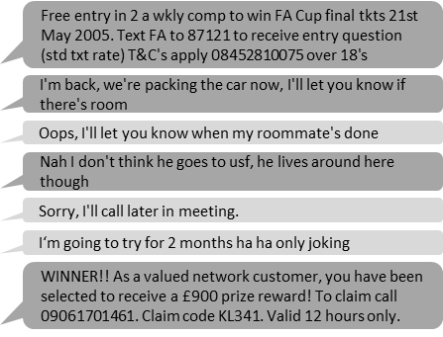




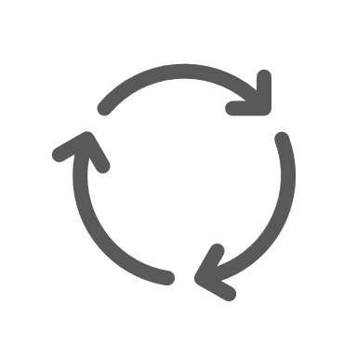
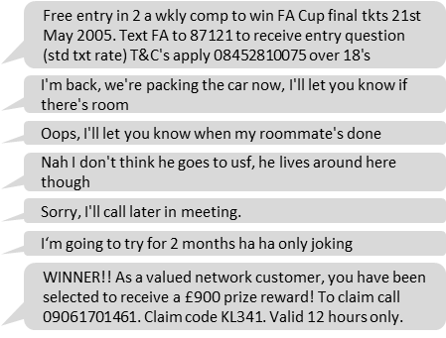
The Traditional Data Analytics Paradigm
Start by study the given problem, including
Determining the target – the output of the analysis
Extract/engineer the necessary features from the data to be used in the analysis
Develop a set of rules that map the features in data to the output
Evaluate if the set of rules is effective or not
If the set of rules is good, launch the product
Otherwise, determine the issues, then return to step 1 and repeat
This paradigm requires user monitoring in all steps
Production
Evaluation
Analyze
errors
Pattern | Point
Longer than 30 words | 1
Includes “WINNER!!!” | 2
Includes “T&C’s applied” | 2
Sent from 123 321 1234 | 5
… | …
Manually
Observation
Spams usually longer than 30 words
Spams may include “WINNER!!!”
Spams may include “T&C’s applied”
All from 123 321 1234 are spam
…
length | Include WINNER | Include T&C | Has link to … | …
19 | 1 | 1 | 0 | …
28 | 1 | 1 | 1 | …
5 | 0 | 0 | 0 | …
12 | 1 | 0 | 0 | …
31 | 1 | 1 | 0 | …
Raw data
Study problem
Extract feature and write rules

Slide 6
Problems with the Traditional Paradigm
Need extensive monitoring from the analysts
Subjective in terms of the analysts
Does the user have enough domain knowledge
Is the user bias to certain output
Need to repeat the whole process when new data comes

Slide 7
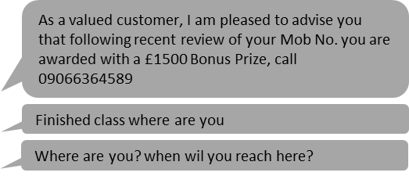

The Machine Learning Data Analytics Paradigm
Machine learning eliminates a lot of needs for human monitoring in analytics
That is not to say it can do everything by itself
The models can learn from data, or be trained from data to determine
Which features are important
New features that are not known to the users
Which set of rules will best map features to the desired output
Machine learning models can continue learning to adapt to new data
Key difference: Machine learning models learn from data (or are trained from data) instead of being built step-by-step by analysts
Production
Automated
Update data
Optional
Can also be automated
Evaluation
0.13 | 0.85 | 0.17 | 0.53 | …
0.21 | 0.11 | 0.9 | 0.7 | …
0.44 | 0.22 | 0 | 0 | …
0.62 | 0.12 | 0.9 | 0.11 | …
0.33 | 0.19 | 0.51 | 0.71 | …
0.36 | 0.88 | 0.27 | 0.56 | …
Raw data
Feature Learning
Model Training

Slide 8
Tasks of the Analysts when using Machine Learning
Choose the suitable technique for the problem
Start training the model
Decide if the model is good enough or need more training
Decide if the model is good enough for new data or need new training
You still need to understand the project, monitor and make decision

Slide 9
Branches in Machine Learning
Machine Learning
The focus of this course
Supervised
Learning
Unsupervised Learning
Semi-Supervised Learning
Reinforcement Learning
Classification
Regression
Clustering
Dimension Reduction
Association Rules

Slide 10

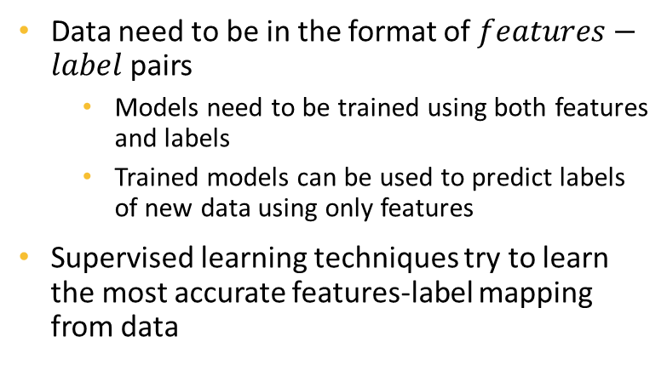
Supervised Learning
New data
Predicted label
Data need to be in the format of $features−label$ pairs
Models need to be trained using both features and labels
Trained models can be used to predict labels of new data using only features
Supervised learning techniques try to learn the most accurate features-label mapping from data
500 New Mobiles from 2004, MUST GO! Txt: NOKIA to No: 89545 & collect yours today! From ONLY £1 www.4-tc.biz 2optout 087187262701.50gbp/mtmsg18
spam
Trained model
Features
Labels
Free entry in 2 a wkly comp to win FA Cup final tkts 21st May 2005. Text FA to 87121 to receive entry question (std txt rate) T&C's apply 08452810075 over 18's
spam
Feed to model
What is being learned
I'm back, we're packing the car now, I'll let you know if there's room
okay
Free entry in 2 a wkly comp to win FA Cup final tkts 21st May 2005. Text FA to 87121 to receive entry question (std txt rate) T&C's apply 08452810075 over 18's
?
spam
Oops, I'll let you know when my roommate's done
okay
?
okay
I'm back, we're packing the car now, I'll let you know if there's room
Nah I don't think he goes to usf, he lives around here though
Oops, I'll let you know when my roommate's done
?
okay
okay
Training process
Nah I don't think he goes to usf, he lives around here though
?
okay

Slide 11
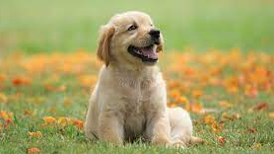
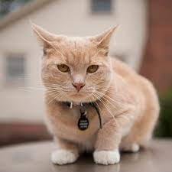
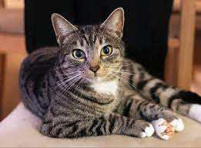
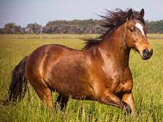
Classification
Free entry in 2 a wkly comp to win FA Cup final tkts 21st May 2005. Text FA to 87121 to receive entry question (std txt rate) T&C's apply 08452810075 over 18's
spam
Subcategory of supervised learning in which the labels are discrete class
Examples:
good or bad
low or medium or high
dog or cat or horse
I'm back, we're packing the car now, I'll let you know if there's room
okay
Oops, I'll let you know when my roommate's done
okay
Nah I don't think he goes to usf, he lives around here though
okay
dog
cat
Enc_SSN | NoOfAcc | Balance | 3MnPstDue | 6MnPstDue
Ad9asgvjabl | 3 | 100 | 0 | 0
CLvb0das9b | 1 | 2500 | 1000 | 500
MCdfasd924 | 4 | 50 | 0 | 0
Mx9ta9fgak4 | 2 | 1200 | 200 | 0
good
bad
horse
good
cat
bad

Slide 12
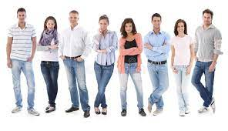


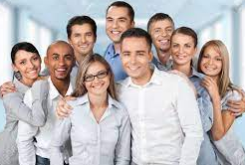
Regression
i`ve been sick for the past few days and thus, my hair looks wierd. if i didnt have a hat on it would look terrible
-3
Subcategory of supervised learning in which the labels are continuous numbers
Examples:
Sentiment scores of texts
Annual incomes of people
Number of people in images
Stock prices, quarterly sales, etc.
Playing Ghost Online is really interesting. The new updates are Kirin pet and Metamorph for third job. Can`t wait to have a dragon pet
5
oh Marly, I`m so sorry!! I hope you find her soon!!
-2
He`s awesome... Have you worked with him before? He`s a good friend.
3
8
1
Enc_SSN | NoOfAcc | Balance | 3MnPstDue | 6MnPstDue
Ad9asgvjabl | 3 | 100 | 0 | 0
CLvb0das9b | 1 | 2500 | 1000 | 500
MCdfasd924 | 4 | 50 | 0 | 0
Mx9ta9fgak4 | 2 | 1200 | 200 | 0
90000
25000
9
95000
5
65000

Slide 13

Unsupervised Learning
Social
Finds patterns in data without predefined labels
This means patterns are determined solely based on input features
Example: based on grades of students on subjects like math, physics, chemistry, literature, history… we can divide them into different groupings
Good at science subjects
Good at social subjects
Good/Average/Bad at both
These output are not defined in the data we collected but derived from the features by the model. Tasks of grouping like this example are also called clustering
Science
Input
Unsupervised model
Output
Social
Science

Slide 14












Another Unsupervised Task: Association Learning
Stores can base on customers’ purchase history to determine their shopping patterns
If someone buys certain combinations of products, it’s more likely they will also buy some other products
Useful for placing items in stores and targeting ads
High chance
Good chance
Good chance

Slide 15
Semi-supervised Learning
A hybrid between supervised and unsupervised learning
Predefined labels are available for a small portions of data
The rest are unlabeled
Unlabeled data

Slide 16





Reinforcement Learning
Trains agents to take actions in an environment that results in the most reward
Is more on the Artificial Intelligence side of machine learning
Environment
Agent
Action?
Environment
Environment
Reward ← -50
Reward ← +50

Slide 17
Course Activities
We begin with examining an end-to-end data analytics project
Gain a whole picture of conducting a data analytics project
Have hands-on at the very beginning of the course
Then we will discuss and practice different components of the project and different machine learning methods
We will be using Python and Jupyter Notebook IDE for the whole course

